Slide 1

Introduction to Rational Unified Process
Pooyan jamshidy
Notes:
In this module, we take a high-level look at the Rational Unified Process, our process for the UML that supports and encourages the best practices we discussed earlier.
Software development is the process of developing a software system from requirements. A software process provides a disciplined approach to assigning tasks and responsibilities within a development organization, to ensure production of a high-quality software product that meets the needs of its end users within a predictable schedule and budget. The Rational Unified Software Process is a software process which incorporates the six principles for software development we have just examined. It codifies them into a formal, written set of procedures and practices that are complete, thorough, and self-consistent.
This module provides a very high level view of the Rational Unified Process. The process itself contains much more detail about each item discussed here.

Slide 2
Objectives: Rational Unified Process
Describe the Unified Modeling Language (UML)
Define what a software development process is
Describe the Rational Unified Process
Explain the four phases of the Rational Unified Process and their associated milestones
Define iterations and their relation to phases
Explain the relations between:
  Models and workflows
  Phases, iterations, and workflows
Define artifact, worker, and activity
State the importance of automated tool support
Notes:
We will focus on the major concepts and definitions of the major terms. We will also describe the notation and terminology used in the definition of the process.

Slide 3
Building a System - A Language Is Not Enough
Team-Based
Development
Modeling
Language
Process
Notes:
The UML provides a standard for the artifacts of development (semantic models, syntactic notation, and diagrams): the things that must be controlled and exchanged. But the UML is not a standard for the process of development.
Despite all of the value that a common modeling language brings, successful development of today’s complex systems cannot be achieved solely by the use of the UML. Successful development also requires the employment of an equally robust development process.
This slide is establishing the need for something beyond the UML. Some students may think: If I know the UML, I’m done. I don’t need a process. But we will establish that the UML, while a good and necessary first step, is not everything that is needed.

Slide 4

What Is the UML?
The Unified Modeling Language (UML) is a language for
    Specifying
    Visualizing
    Constructing
    Documenting
the artifacts of a software-intensive system
Notes:
The software systems we develop today are much more complex than the human mind can comprehend in their entirety. This is why we model systems. The choice of what models to create has a profound influence upon how a problem is attacked and how a solution is shaped. No single model is sufficient; every complex system is best approached through a small set of nearly independent models. To increase comprehension, a common language like the Unified Modeling Language is used to express models.
The RUP is based on the UML, so we first discuss the UML and then explain what the UML does NOT provide. The RUP fills in the gaps.

Slide 5
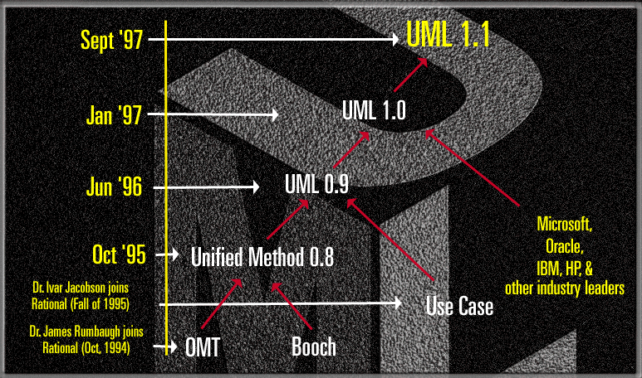
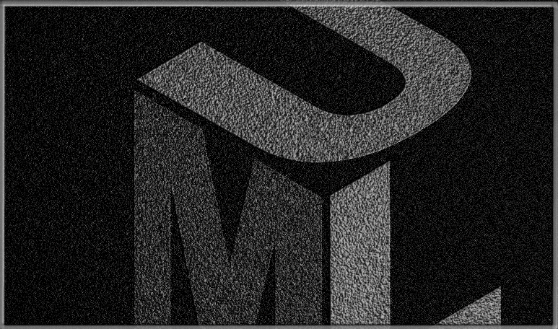
UML History
Notes:
The UML is now the industry standard modeling language. Its development was spearheaded by three leaders in the object-oriented industry: Grady Booch, Ivar Jacobson, and Jim Rumbaugh. Each of them had unique approaches in the early 1990s that were converging independently. Rational Software brought these three industry leaders together to accelerate convergence to a single modeling approach. The UML is the outcome of that effort.
The UML has been under development since 1990. Early versions have gradually converged into the UML standard 1.1 that was adopted unanimously by the OMG in November 1997. Numerous books, articles, and papers have been written about or are using the UML today and many more are to come. And finally, most tool vendors today are supporting the UML.
Version 1.3 of the UML is under development at the present time.
In many cases, the students will already be familiar with this history. Therefore, it is not necessary to spend a lot of time on this slide. The points to make are:
1. Rational provided the leadership to make this happen.
2. Rational did not do this in a secret or proprietary way. Everyone had their say and many companies made significant contributions.
3. UML is a standard and will evolve under the supervision of the OMG.
Version 1.3 is currently expected to be adopted in October 1998.

Slide 6
Inputs to UML
Booch
Rumbaugh
Jacobson
Meyer
Fusion
Before and after
conditions
Operation descriptions,
Message numbering
Embley
Harel
Singleton classes,
High-level view
State charts
Gamma, et.al
Wirfs-Brock
Frameworks, patterns,
notes
Responsibilities
Shlaer - Mellor
Odell
Object Lifecycles
Classification
Notes:
UML development included incorporating ideas from numerous other methodologists. The main challenge was constructing an approach that was simple yet allowed the modeling of a broad range of systems. The conceptual framework was established quickly but the notational semantics took more time.
Active collaboration with other industry leaders has brought unique expertise and experience into the UML effort. The UML effort was supported by a large cross-section of the industry. Partners in the UML effort included HP, ICON Computing, IBM, I-Logix, Intellicorp, MCI Systemhouse, Microsoft, ObjecTime, Oracle, Platinum Technology, Ptech, Reich Technologies, Softeam, Sterling Software, Taskon, and Unisys. These partners provided contributors, reviewers, and advocates for the standardization efforts.
In the end, a modeling language was created that has already stood up to the test of widespread use in the industry and to the scrutiny of international standardization efforts.
Again, this is a slide you do not need to spend a lot of time on. You might just want to point out one or two contributors of special interest to your audience. For example, for a telephony audience, you might point out Harel and his state charts.

Slide 7
The UML Provides Standardized Diagrams
State
Diagrams
State
Diagrams
Class
Diagrams
Use Case
Diagrams
Use Case
Diagrams
State
Diagrams
Use Case
Diagrams
Use Case
Diagrams
State
Diagrams
Use Case
Diagrams
Object
Diagrams
Activity
Diagrams
Scenario
Diagrams
State
Diagrams
Scenario
Diagrams
State
Diagrams
Sequence
Diagrams
State
Diagrams
Model
Scenario
Diagrams
Component
Diagrams
Scenario
Diagrams
Component
Diagrams
Collaboration
Diagrams
Deployment
Diagram
Component
Diagrams
Notes:
In building a visual model of a system, many different diagrams are needed to represent different views of the system. The UML provides a rich notation for visualizing our models. This includes the following key diagrams:
Use Case diagrams to illustrate user interactions with the system.
Class diagrams to illustrate logical structure.
Object diagrams to illustrate objects and links.
State diagrams to illustrate behavior.
Component diagrams to illustrate physical structure of the software.
Deployment diagrams to show the mapping of software to hardware configurations.
Interaction diagrams (i.e., collaboration and sequence diagrams) to illustrate behavior.
Activity diagrams to illustrate the flow of events in a use case.
This diagram was also shown in the previous module. We are repeating it here because we will provide examples of a few of these diagrams on the pages which follow.
The UML emphasizes a graphical language for representing models, but provides little/no guidance on when and how to use these diagrams. This is an area where the RUP helps. It describes the kinds of project artifacts needed, including diagrams, and puts them in the context of an overall project plan.

Slide 8
A Sample UML Diagram: Use Cases
A University Course Registration System
Login
Registrar
Maintain Professor Information
View Report Card
Student
Register for Courses
Maintain Student Information
Course Catalog
Close Registration
Billing System
Select Courses to Teach
Professor
Submit Grades
Notes:
Use case diagrams are used to show the existence of use cases and their relationships, both to each other and to actors. An actor is something external to the system that has an interface with the system, such as users. A use case models a dialogue between actors and the system. A use case is initiated by an actor to invoke a certain functionality in the system. For example, in the diagram above, one user of the system is a student who wishes to use the system to register for courses. Hence, Register for Courses is a use case.
The arrow (which is optional) indicates the direction of initiation of the interaction. For example, the Student actor initiates the Register for Courses use case. However, the Close Registration use case initiates interaction with the Billing System.
A use case is a complete and meaningful flow of events. The flow of events supplements the use case diagram and is usually provided in text format.
Taken together, all use cases constitute all possible ways of using the system.
For this diagram and the subsequent one, the purpose is just to familiarize the student with the rich language of the UML which is available to represent software artifacts. You should NOT try to explain all the notation, just the purpose of the diagram and how to read it (superficially).
A use case has a set of properties: brief description, flow of events, special requirements, etc. Use cases are enclosed in the use-case-model artifact.

Slide 9
A Sample UML Diagram: Classes
A University Course Registration System
<<boundary>>
<<boundary>>
MaintainScheduleForm
MainForm
1
0..1
// select maintain schedule()
1
+ // open()
+ // select 4 primary and 2 alternate offerings()
1
1
<<boundary>>
1
0..*
<<control>>
CourseCatalogSystem
RegistrationController
// get course offerings()
// add courses to schedule()
// get course offerings ()
0..1
1
<<entity>>
Schedule
// create with offerings()
Notes:
A class diagram is a view of the classes composing the system, as well as their relationships. Classes are represented by rectangles. Relationships are represented by lines. The presence of a relationship between two classes indicates that they collaborate in some way in performing one or more use cases. For example, the relationship between MainForm and MaintainScheduleForm means that a MainForm may or may not contain one MaintainScheduleForm.
The items preceded by “//” in the lower third of the class boxes indicate the responsibilities of the classes. For example, CourseCatalogSystem is responsible for get course offerings. During design of this class, this responsibility will be turned into one or more operations.
The items within angle brackets (“<< >>”) indicate the stereotype of the class. For example, CourseCatalogSystem is a boundary class which means that it interfaces with an external entity (I.e., an actor).
This is presented as another example of UML notation. It is probably the UML diagram with which most students are familiar.
This diagram contains a wealth of detail, so try to just make the students focus on the intent of the diagram (classes and relationships) rather than the individual symbols. Interpretations of all of the symbols are provided in the student notes.
In case they ask, the middle third of the boxes (looks like a stripe in the diagram) is really another compartment in which the attributes (I.e., data elements) of the class can be listed.
Developers tend to focus on this diagram because it tells them what classes need to be coded (and auto generation of code is done from this diagram).
Emphasize the value of the UML: Booch used to use dashed clouds to represent classes, while Rumbaugh (OMT) used rectangles. This made it difficult for us to understand each other’s class diagrams.

Slide 10
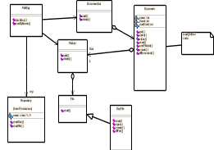
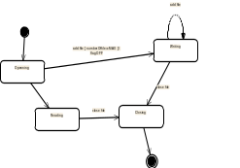

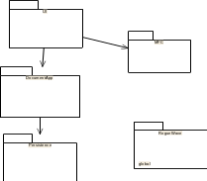
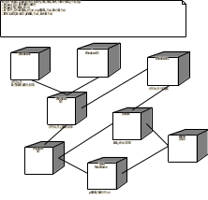
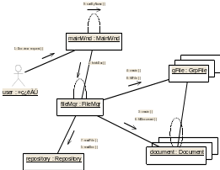
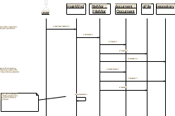
UML Diagrams Are Key System Artifacts
Use-Case Diagram
Class Diagram
State Diagram
Actor A
Use Case 1
Actor B
Use Case 2
<<entity>>
Customer
Deployment
Diagram
Domain
Expert
name
addr
receive()
Use Case 3
withdraw()
fetch()
send()
Class
DocumentList
Repository
Package
Diagram
FileManager
Document
User Interface
Definition
GraphicFile
File
FileList
Collaboration Diagram
Component
Diagram
Forward Engineering(Code Generation)
and
Reverse Engineering
Source Code edit, compile, debug, link
Sequence Diagram
Executable System
Notes:
The UML provides a single, common modeling language that is useable across many methods, across the entire lifecycle, and across many different implementation technologies. It maps the artifacts between business engineering, requirements capture and analysis, design, implementation, and test. It defines an expressive and consistent notation that can point out omissions and inconsistencies. It scales to support very small to very large systems development. If facilitates effective communications with all members of the development team.
We are beginning the transition from the UML to the RUP. The students are not expected to be able to read this slide. The point is just to summarize all of the UML diagrams used for visual modeling.
You might point out that learning the UML and all of its diagrams is not enough for a developer to be successful. It is similar to learning a natural language like English by reading the dictionary. You might know all the words and even the syntax, but you wouldn’t be able to effectively communicate. So the UML is a crucial first step as it gives us a common language with which to communicate. But a process is needed to understand how to apply the UML to ensure successful development efforts. That’s why we developed the RUP.
Activity diagrams are not shown on the slide. Activity diagrams can be used to model workflows in business process engineering.

Slide 11
What Is a Process?
A process defines Who is doing What, When and How to reach a certain goal. In software engineering the goal is to build a software product or to enhance an existing one
New or changed
requirements
Software Engineering
Process
New or changed
system
Notes:
The UML is a generic modeling language. With UML, you can produce blueprints for any kind of software system.
The Rational Unified Process (RUP) is a generic process that uses UML as a modeling language. RUP can be used for any kind of software system.
It can be very difficult to explain what a process is, if people aren’t already familiar with it. An informal example most people can relate to is the process of balancing a checkbook at the end of the month. Most of us have developed a process we use - the same steps every month. It shortens the time required to accomplish the task and ensures that we don’t forget any steps. The same applies to a software engineering process. We want it to be repeatable and ensure that all required tasks are accomplished when required. Of course, a software engineering process is much more complex than balancing a checkbook and there is a tremendous amount of information contained in the RUP.

Slide 12
An Effective Process ...
Provides guidelines for efficient development of quality software
Reduces risk and increases predictability
Captures and presents best practices
  Learn from other’s experiences
  Mentor on your desktop
  Extension of training material
Promotes common vision and culture
Provides roadmap for applying tools
Delivers information on-line, at your finger tips
Notes:
The focus of the process is the production of high-quality executables with a minimum of overhead, rather than what documents to produce.
By providing a “written-down”, very detailed set of procedures for developing software according to Rational’s six best practices, the process is easier to apply and repeatable. This results in software projects that are more predicable and successful.
Another feature of the Rational Unified Process is that it is not just theory. It instructs the developer on how to implement the activities using the tools the developer is using.
Finally, the process is available on-line as a Website. While hardcopy books have their place, most developers prefer to reference the process from their desktops when they need help. Both hardcopy and on-line versions are available.
This is a good opportunity to contrast the RUP with old-fashioned processes. RUP is meant to be used on a daily basis. It is relevant because it is integrated with the tools the developer is using. It is easy to access since it is on the desktop.
Emphasize that the process contains far more information than any one person can remember. It is not intended that they learn it all at once. The best approach is to first get an overview so that they understand how it is organized and where to look for things. Then access the online process to learn the details of each task as they need to perform the task.

Slide 13
Rational Unified Process Delivers Best Practices
Rational Unified Process describes how to effectively implement the six best practices for software development
Manage Requirements
Use
Component
Architectures
Develop
Iteratively
Model
Visually
Verify
Quality
Control Changes
Notes:
The six best practices examined in the previous module provide the basis for the Rational Unified Process. However, their effective application requires step-by-step instructions. These instructions are provided in the Rational Unified Process, which looks at all activities that must be performed to build a software product and describes how to conduct those activities consistent with the 6 best practices. Tool mentors are included to explain how to conduct those activities using the Rational tool set.
This ties the process back to the 6 best practices already covered. The 6 best practices are embodied in the process. The process provides direction on how to apply the 6 best practices throughout the life cycle.

Slide 14
Rational Unified Process Is Use-Case Driven
An actor is someone or something outside the system that interacts with the system
A use case is a sequence of actions a system performs that yields an observable result of value to a particular actor
Check Balance
Client
Withdraw Money
Use Cases for a Cash Machine
Notes:
Managing requirements is one of the six best practices already discussed. In particular, the Rational Unified Process captures and manages functional requirements in a use case model. Use cases are a key concept within the process. They are used throughout the development cycle as a driver for many activities, flowing information through several models, and encouraging consistency across these models.
An actor can be a human being or another system or a device; anything external with which the system interacts.
A use case describes functionality from the user’s point of view. A bank client can use a cash machine to withdraw money or check the balance of her account. Each use case (oval) represents something that the system does to provide value to the bank’s customer, the Client. The collected use cases constitute the use-case model and represent all the possible ways of using the system. The use-case model is a model of the system’s intended functions and its environment, and it serves as a contract between the customer and the developers.
The use-case model is complemented by non-functional specifications covering some of the aspects that cannot be easily conveyed by a use case, or that apply to many or all use cases; for example, high-level product requirements, development constraints, safety or security attributes, and so on.
The notation used for representing the use-case model in diagrams is standard notation provided by the UML.
The goal of the next few slides is to give students an overall understanding of what it means to say that the RUP is use-case driven, without getting bogged down into the details of use-case development. Only the most basic terminology and symbols are used.
The example model is incomplete. You might ask students what other use cases they would expect a cash machine to provide.

Slide 15
Use Cases Include a Flow of Events
Flow of events for the Withdraw Money Use Case
  1. The use case begins when the client inserts her ATM card. The system reads and validates information on the card.
  2. The system prompts for the PIN. The system validates the PIN.
  3. The system asks which operation the client wishes to perform. The client selects “Cash withdrawal.”
  4. The system requests the amount. The client enters the amount.
  5. The system requests the account type. The client selects checking or savings.
  6. The system communicates with the ATM network . . .
Notes:
The most important part of the use case is the its flow of events, describing the sequence of actions. It is written in natural language, in a simple, consistent prose, with a precise use of terms, drawing upon a common glossary of the problem domain. For example, the term “ATM” would be an acronym commonly used in the banking industry and defined in the project glossary (as Automated Teller Machine).
The example is incomplete. Just enough steps are provided to illustrate the simplicity and informality of this approach.

Slide 16
Benefits of a Use-Case Driven Process
Use cases are concise, simple, and understandable by a wide range of stakeholders
  End users, developers and acquirers understand functional requirements of the system
Use cases drive numerous activities in the process:
  Creation and validation of the design model
  Definition of test cases and procedures of the test model
  Planning of iterations
  Creation of user documentation
  System deployment
Use cases help synchronize the content of different models
Notes:
The important point to get across is that use cases permeate all parts of RUP and are a key mechanism in accomplishing the Managing Requirements best practice.

Slide 17
Rational Unified Process Is Architecture-Centric
Architecture is the focus of the elaboration phase
  Building, validating, and baselining the architecture constitute the primary objective of elaboration
The Architectural Prototype validates the architecture and serves as the baseline for the rest of development
The Software Architecture Description is the primary artifact that documents the architecture chosen
Other artifacts derive from architecture:
  Design guidelines including use of patterns and idioms
  Product structure
  Team structure
Notes:
Use of component-based architectures is one of the six best practices already discussed. Architecture is used in the Rational Unified Process as a primary artifact for conceptualizing, constructing, managing, and evolving the system under development. The Rational Unified Process emphasizes early development and validation of software architecture as a core concept. It defines two primary artifacts related to architecture: the Software Architecture Description (SAD) which describes the architectural views relevant to the project and the Architectural Prototype. The Rational Unified Process also defines a worker, called the Architect, who is responsible for the architecture. The bulk of the activities related to architectural design are described in the analysis and design workflow, but it spills over to the requirements workflow, the implementation workflow, and the project management workflow.
Architecture was defined and explained in the Best Practices module already presented. Here we assume that the student remembers this material. You may wish to briefly review the definition of architecture and relate it to blueprints,etc.

Slide 18
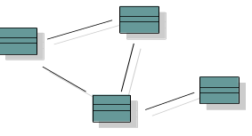

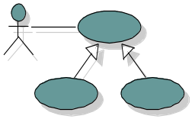
Representing Architecture: The 4+1 View Model
Logical View
Implementation View
Analysts/
Designers
End-user
Programmers
Software management
Structure
Functionality
Use-Case View
Process View
Deployment View
System Integrators
System Engineering
Performance
Scalability
Throughput
System topology
Delivery, installation
communication
Notes:
Many different parties are interested in the architecture (e.g., the system analyst, the designers, the end uses, etc.). To allow these parties or stakeholders to communicate, discuss and reason about architecture, we need to have an architectural representation that they understand. Because different stakeholders have different concerns and because architecture is quite complex, multiple views are required to represent architecture adequately. An architectural view is a simplified description (an abstraction) of a system from a particular perspective or vantage point, covering particular concerns,and omitting entities that are not relevant to this perspective.
While many views of architecture can be useful, the Rational Unified Process identifies 4+1 views as a standard set:
The logical view addresses the functional requirements of the system. It is an abstraction of the design model, identifying major design packages, subsystems and classes.
The implementation view describes the organization of static software modules in the development environment, in terms of packaging, layering, and configuration management.
The process view addresses the concurrent aspect of the system at run-time: tasks, threads or processes, and their interactions.
The deployment view shows how the various executables and other run-time components are mapped onto the underlying platforms or computing nodes.
The use-case view contains a few key scenarios or use cases that are used to drive the architecture and to validate it.
It is important to keep the discussion of this slide at a very high level. Examples of the 5 views are not provided. You may wish to go to the white board and show some examples. Several examples from earlier in this module can be used. For example, The sample use case diagram can illustrate the use-case view. The sample class diagram can illustrate the logical view.
Also mention that the UML provides the notation we use to visualize these views.

Slide 19
Benefits of an Architecture-Centric Process
Architecture lets you gain and retain intellectual control over a project, to manage its complexity, and to maintain system integrity
Architecture provides an effective basis for large-scale reuse
Architecture provides a basis for project management
Architecture facilitates component-based development
  A component fulfills a clear function in the context of a well-defined architecture
  A component conforms to and provides the physical realization of a set of interfaces
  Components exist relative to a given architecture
Notes:
A complex system is more than the sum of its parts, more than a succession of small independent tactical decisions. It must have some unifying, coherent structure to organize those parts systematically, and provide precise rules on how to grow the system without having its complexity “explode” beyond human understanding. Architecture provides this structure and these rules.
By clearly articulating the major components and the critical interfaces among them, an architecture lets you reason about reuse, both internal reuse (the identification of common parts), and external reuse (the incorporation of ready-made, off-the-shelf components. Architecture can also facilitate reuse on a larger scale: the reuse of the architecture itself in the context of a product line that addresses different functionality in a common domain.
Planning and staffing are organized along the lines of major components: layers and subsystems.
Components and architecture are two intertwined concepts: the architecture identifies components, their interfaces and interactions, along several dimensions, and components exist only relative to a given architecture. You cannot mix-and-match components that you pick if they have not been made to fit.

Slide 20
Process Architecture - Lifecycle Phases
Inception
Elaboration
Construction
Transition
time
The Rational Unified Process has four phases:
  Inception - Define the scope of project
  Elaboration - Plan project, specify features, baseline architecture
  Construction - Build the product
  Transition - Transition the product into end user community
Notes:
During Inception, we define the scope of the project, what is included, and what is not. This is done by identifying all the actors and use cases, and by drafting the most essential use cases (usually approximately 20% of the complete model). A business plan is developed to determine whether resources should be committed to the project.
During Elaboration, we focus on two things: get a good grasp of the requirements (90% complete) and establish an architectural baseline. If we have a good grasp of the requirements and the architecture, we can eliminate a lot of the risks and will have a good idea what amount of work remains to be done. Detailed cost/resource estimations can be made at the end of Elaboration.
During Construction, we build the product in several iterations up to a beta release.
During Transition, we transition the product to the end user and focus on end user training, installation, and support.
The amount of time spent in each phase varies. For a very complex project with a lot of technical unknowns and unclear requirements, Elaboration may include 3-5 iterations. For a very simple project where requirements are known and the architecture is simple, Elaboration may include only a single iteration.
The student notes are quite extensive. There is no need to go into that much detail in class. The important thing is to understand how the RUP uses phases to organize the life cycle.
You can also mention that we deliberately chose names that do not match the waterfall names (analysis, design, implementation, and test) to emphasize that they are NOT the same as the waterfall phases.
Some ways of describing the phases in common terminology:
Inception - bid and proposal
Elaboration - Building blueprints
Construction - I think I’m done
Transition - how do users react?

Slide 21
Phase Boundaries Mark Major Milestones
Inception
Elaboration
Construction
Transition
time
Lifecycle
Objective
Milestone
Lifecycle
Architecture
Milestone
Initial Operational
Capability
Milestone
Product
Release
Notes:
At each of the major milestones,the project is reviewed and a decision made as to whether to proceed with the project as planned, to abort the project, or to revise it. The criteria used to make this decision vary by phase.
The evaluation criteria for the inception phase (LCO) include: stakeholder concurrence on scope definition and cost/schedule estimates; requirements understanding as evidenced by the fidelity of the primary use cases; credibility of cost/schedule estimates, priorities, risks, and development process; depth and breadth of any architectural prototype; actual expenditures versus planned expenditures.
The evaluation criteria for the elaboration phase (LCA) include: stability of the product vision and architecture; resolution of major risk elements; adequate planning and reasonable estimates for project completion; stakeholder acceptance of the product vision and project plan; acceptable expenditure level.
The evaluation criteria for the construction phase (IOC) include: stability and maturity of the product release (I.e., is it ready to be deployed?); readiness of the stakeholders for the transition; acceptable expenditure level.
At the end of the transition phase, a decision is made whether to release the product. This will be based primarily on the level of user satisfaction achieved during the transition phase. Often this milestone coincides with the initiation of another development cycle to improve or enhance the product. In many cases, this new development cycle by already be underway.
The student notes are extensive and there is no need to go into detail with each milestone. The most important point to get across is that there are formal milestones marking major decision points with the RUP lifecycle just like there is in the waterfall.
The criteria listed in the student notes are extensive because they are thorough. However, only one or two of the criteria at each point are really important. The ones to emphasize are:
LCO: scope agreed upon and risks understood and reasonable
LCA: high risks addressed and architecture stable
IOC: product is complete and quality acceptable

Slide 22
Iterations and Phases
Inception
Elaboration
Construction
Transition
Preliminary
Iteration
Architect.
Iteration
Architect.
Iteration
Devel.
Iteration
Devel.
Iteration
Devel.
Iteration
Transition
Iteration
Transition
Iteration
Minor Milestones: Releases
An iteration is a distinct sequence of activities with an established plan and evaluation criteria, resulting in an executable release (internal or external)
Notes:
Within each phase, there is a series of iterations. The number of iterations per phase will vary. Each iteration results in an executable release encompassing larger and larger subsets of the final application.
An internal release is kept within the development environment and (optionally) demonstrated to the stakeholder community. An external release is provided to stakeholders (usually users) for installation in their own environment. External releases are much more expensive (they require user documentation and technical support) and normally occur only during the transition phase.
The end of an iteration marks a minor milestone. It is a point in time when technical results are assessed and future plans revised as necessary.

Slide 23
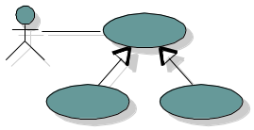
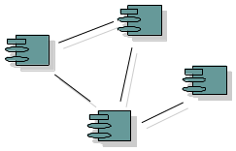
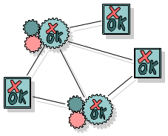
Major Workflows Produce Models
Business
Modeling
supported by
Business Model
Requirements
realized by
Use-Case
Model
Analysis & Design
implemented by
Design
Model
Implementation
verified by
Implementation
Model
Test
Test
Model
Notes:
The Rational Unified Process is a model-driven approach. Several models are needed to fully describe the evolving system. Each major workflow produces one of those models. The models are developed incrementally across iterations.
The Business Model is a model of what the business processes are and the business environment. It can be used to generate requirements on supporting information systems.
The Use-Case Model is a model of what the system is supposed to do and the system environment.
The Design Model is an object model describing the realization of use cases. It serves as an abstraction of the implementation model and its source code.
The Implementation Model is a collection of components, and the implementation subsystems that contain them.
The Test Model encompasses all of the test cases and procedures required to test the system.
You can relate this back to previous slides that describe the system model and the many diagrams needed to fully communicate its content. One can consider all of the models listed here, taken together, to be “the system model.”
The only model that is a little different is the business model. It describes the business at large, not just the automated part. The other models describe the information system that supports the business model.
It is a good idea to point out that each of these models is incrementally developed across many iterations.

Slide 24
Bringing It All Together: The Iterative Model
In an iteration, you walk through all workflows
Phases
Process Workflows
Inception
Elaboration
Construction
Transition
Business Modeling
Requirements
Analysis & Design
Implementation
Test
Deployment
Supporting Workflows
Configuration Mgmt
Management
Workflows group activities logically
Environment
Preliminary
Iteration(s)
Iter.
#1
Iter.
#2
Iter.
#n
Iter.
#n+1
Iter.
#n+2
Iter.
#m
Iter.
#m+1
Iterations
Notes:
This graphic illustrates how phases and iterations, or the time dimension, relates to the development activities performed, or the workflow dimension. The relative size of the color area indicates how much of the activity is performed in each phase/iteration.
Each iteration involves activities from all workflows. The relative amount of work related to the workflows changes between iterations. For instance, during late Construction, the main work is related to Implementation and Test and very little work on Requirements is done.
Note that requirements are not necessarily complete by the end of Elaboration. It is acceptable to delay the analysis and design of well-understood portions of the system until Construction because they are low in risk.
Can iterations overlap?
No. Our model is to show no overlap among iterations. In a large project, several teams may work in parallel on their portions of the iteration, but we do not consider these to be separate iterations.
How many iterations should you have?
It depends on many factors. Err on the side of too many iterations.
Animation note: The callouts and black rectangle appear 2 seconds after the slide.

Slide 25
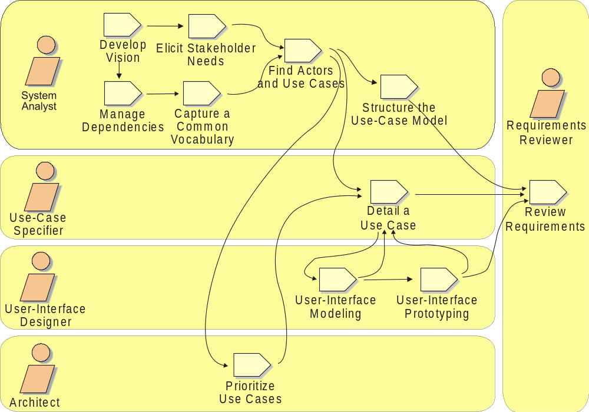
Requirements Workflow
Notes:
The purposes of the Requirements workflow are:
To come to an agreement with the customer and the users on what the system should do.
To give system developers a better understanding of the requirements on the system.
To delimit the system.
To provide a basis for planning the technical contents of iterations.
To define a user-interface for the system.
To achieve these goals, a Vision document, a Stakeholder Needs document, a use-case model, and a Supplementary Specification document are developed that describes what the system will do - an effort that views customers and potential users as important sources of information (in addition to system requirements).
Complementary to the above mentioned artifacts, the following artifacts are developed:
Glossary
Use-Case Storyboard
Boundary Class
User-Interface Prototype

Slide 26
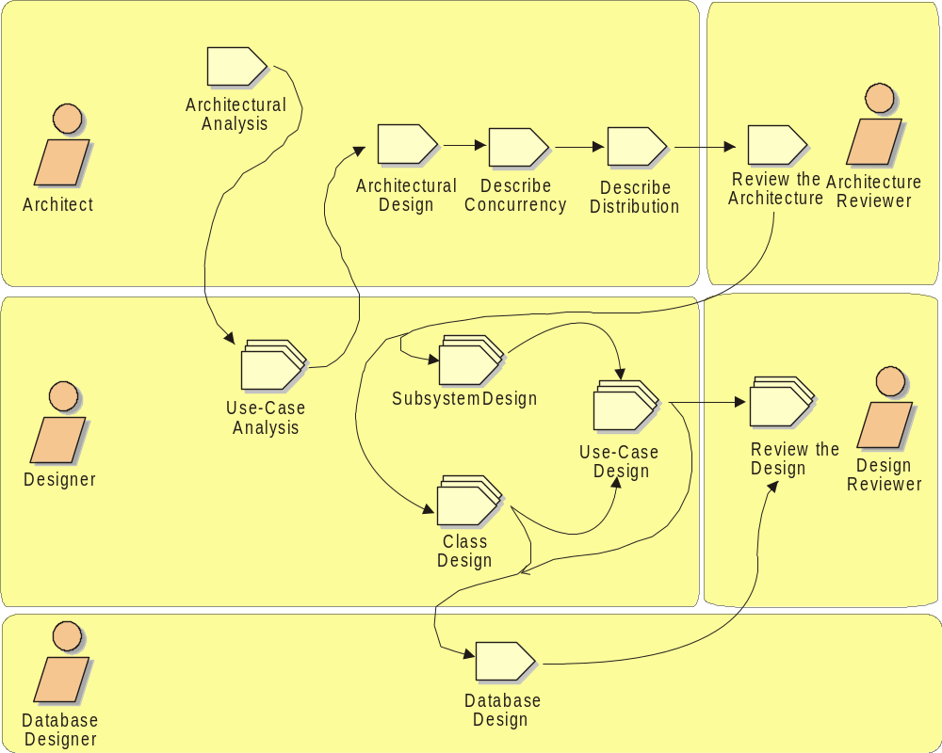
Analysis & Design Workflow
Notes:
The purposes of the Analysis and Design workflow are:
To transform the requirements into a design of the system to-be.
To evolve a robust architecture for the system.
To adapt the design to match the implementation environment, designing it for performance.
The primary artifacts of the Analysis and Design workflow are:
Design model, defining use case realizations, classes, and design packages/subsystems
Software Architecture Document
Data model

Slide 27
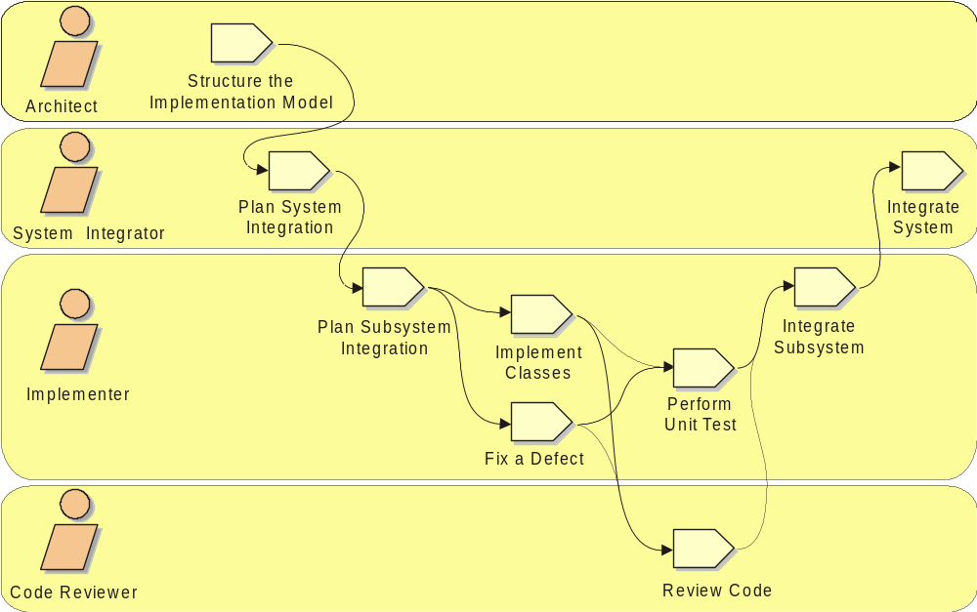
Implementation Workflow
Notes:
The purposes of the Implementation workflow are:
To define the organization of the code, in terms of implementation subsystems organized in layers.
To implement classes and objects in terms of components (source files, binaries, executables, and others).
To test the developed components as units.
To integrate the results produced by individual implementers (or teams), into an executable system.
The Implementation workflow limits its scope to how individual classes are to be unit tested. System test and integration test are described in the Test workflow.
The primary artifacts of the Implementation workflow are:
Implementation model, defining components and implementation subsystems
Integration Build Plan

Slide 28
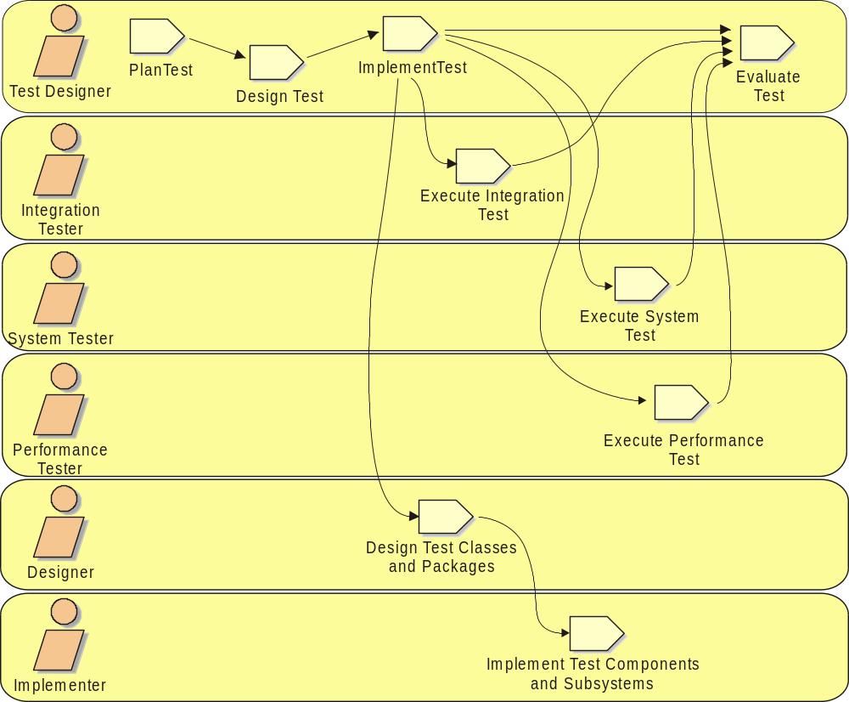
Test Workflow
Notes:
The purposes of the Testing workflow are:
To verify the interaction between objects.
To verify the proper integration of all components of the software.
To verify that all requirements have been correctly implemented.
To identify and ensure defects are addressed prior to the deployment of the software.
The primary artifacts of the Testing workflow are:
Test model, defining test cases, procedures, and scripts
Test Plans
Defects
Test packages, classes, subsystems, and components

Slide 29
Summary: Rational Unified Process
The Unified Modeling Language (UML) is a language for specifying, visualizing, constructing, and documenting the artifacts of a software-intensive system
A software development process defines Who is doing What, When and How in building a software product
The Rational Unified Process has four phases: Inception, Elaboration, Construction and Transition
Each phase ends at a major milestone and contains one or more iterations
An iteration is a distinct sequence of activities with an established plan and evaluation criteria, resulting in an executable release

